Slide 1
Capstone Project:
Google Play Store Apps
Exploratory Data Analysis
By:- Shaik Yaseen Mahemood
shaikyaseenmahemood2000@gmail.com

Slide 2
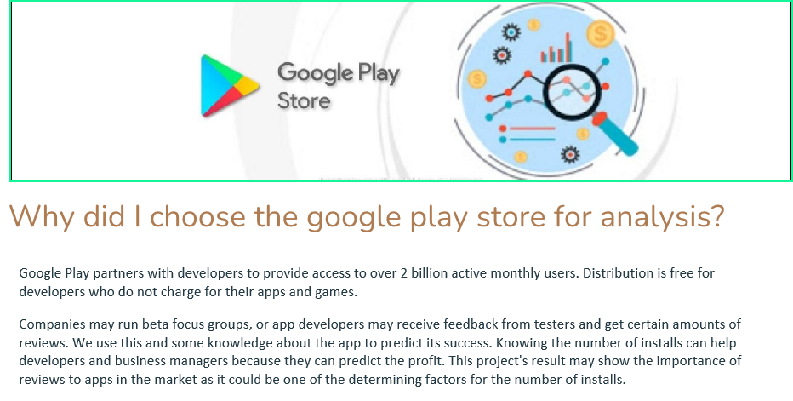

Slide 3
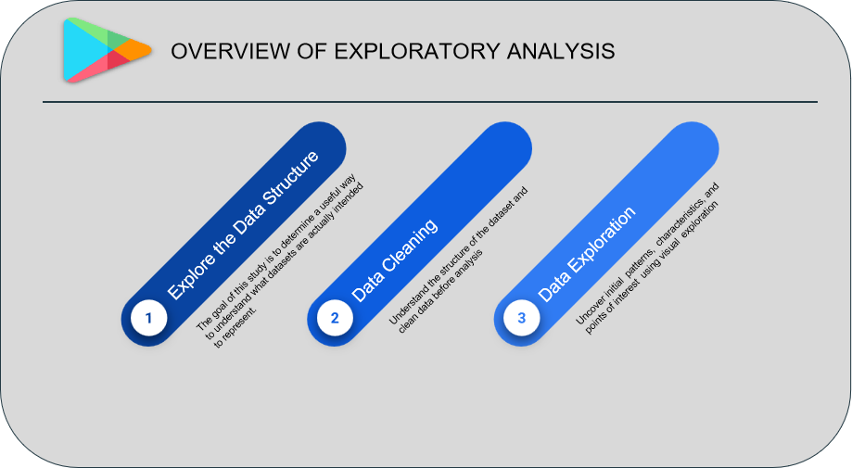

Slide 4
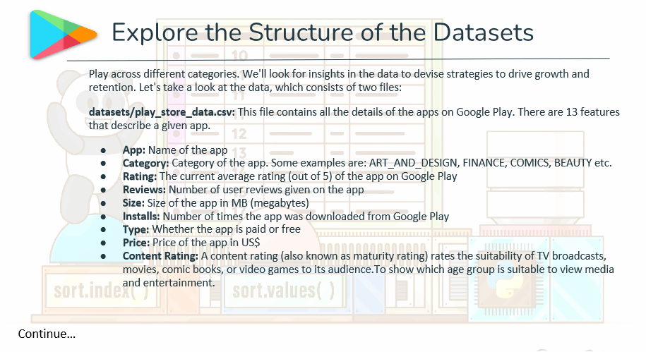

Slide 5
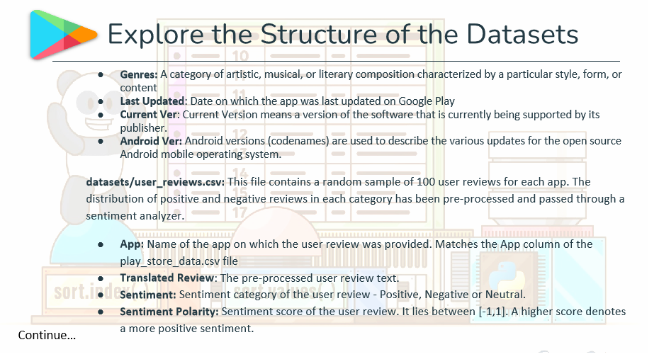

Slide 6
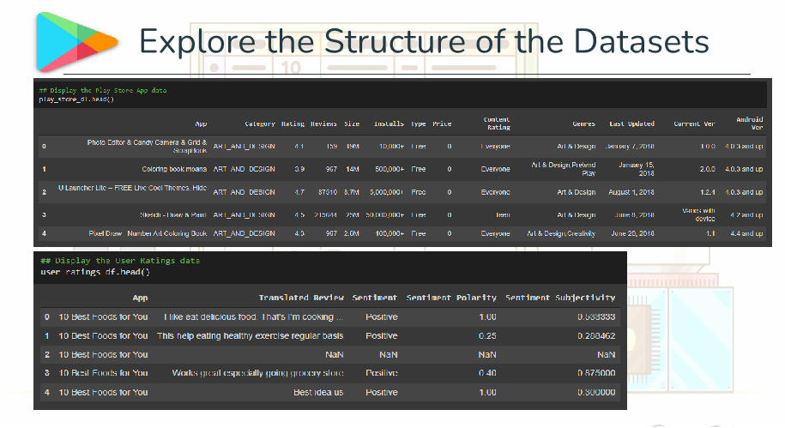

Slide 7
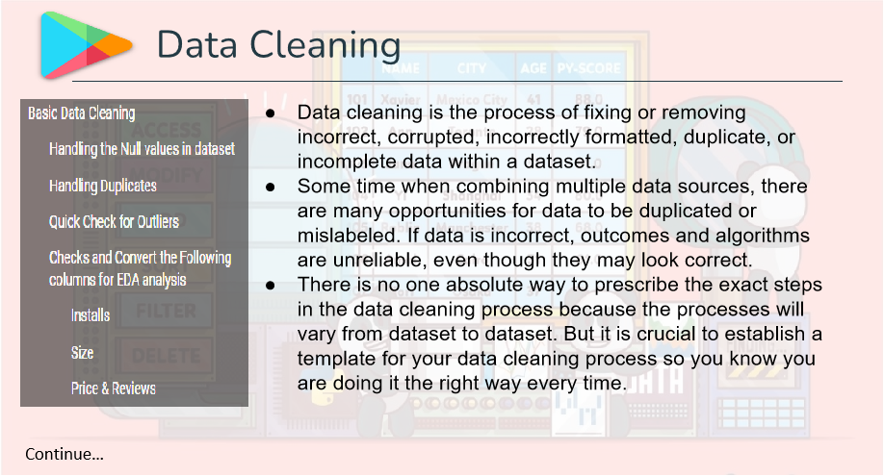

Slide 8
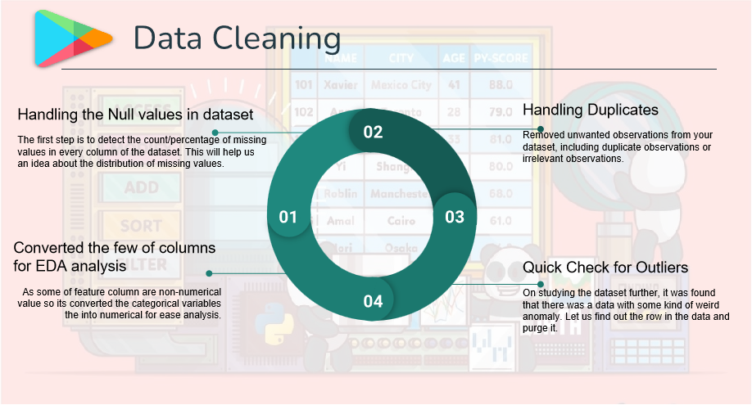

Slide 9
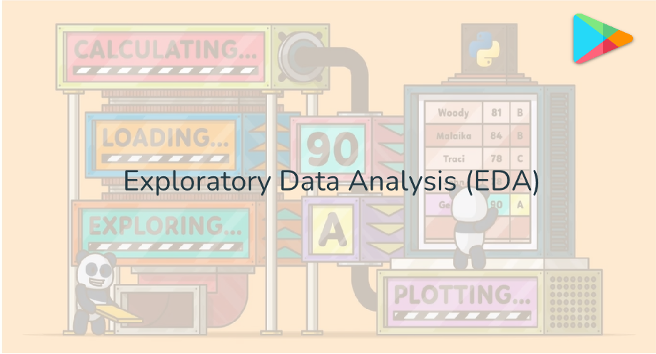

Slide 10
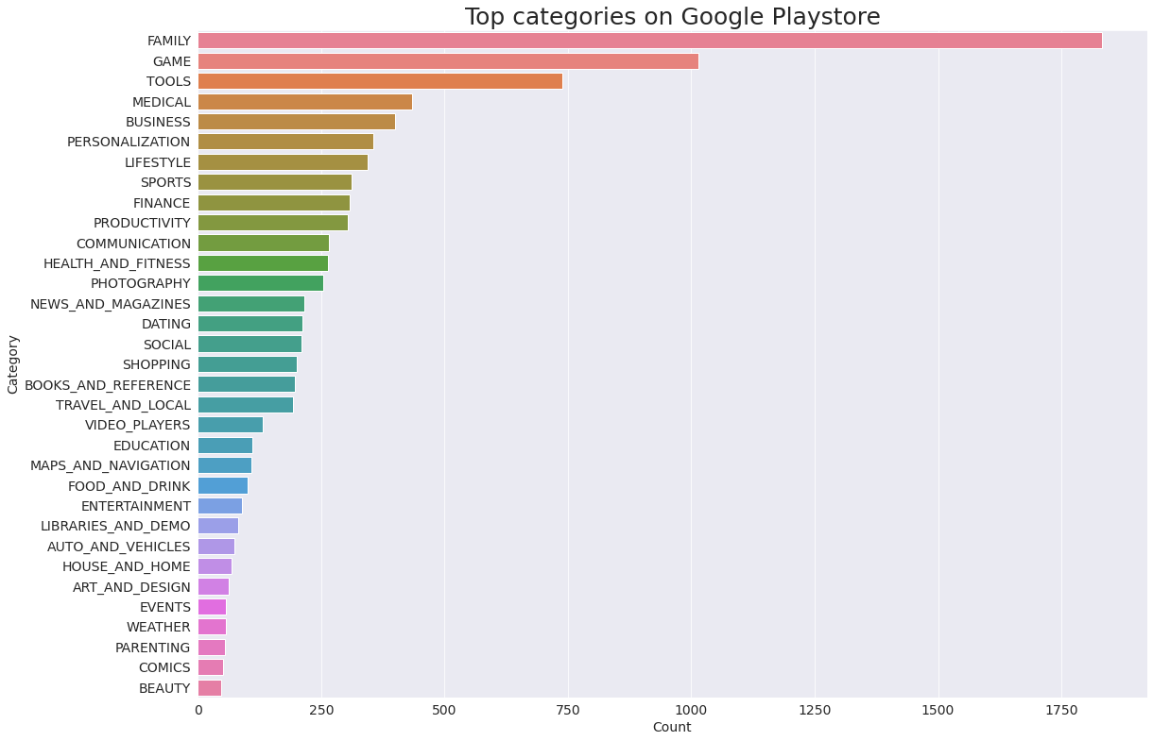
what are the top categories in the play store, which contains the highest number of apps?
So there are all total of 33 categories in the dataset from the above output we can come to the conclusion that in the play store most of the apps are under Family & Game category and least are of Beauty & Comics Category.

Slide 11
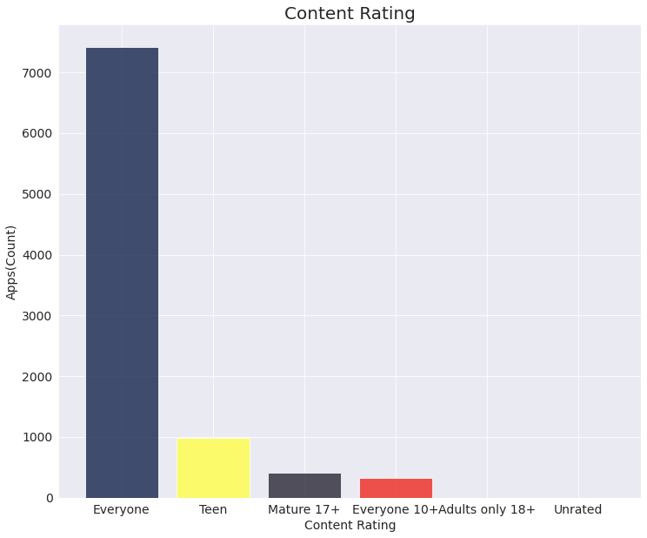
Which category of Apps from the ‘Content Rating’ column is found more on the play store?
From the above plot, we can see that the Everyone category has the highest number of apps.

Slide 12
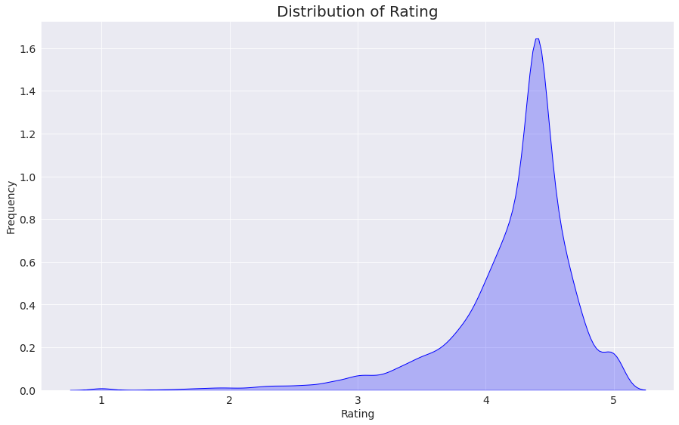
Let’s have a look at the distribution of the ratings of the data frame.
From the above graph, we can come to the conclusion that most of the apps in the google play store are rated between 3.5 to 5.1

Slide 13
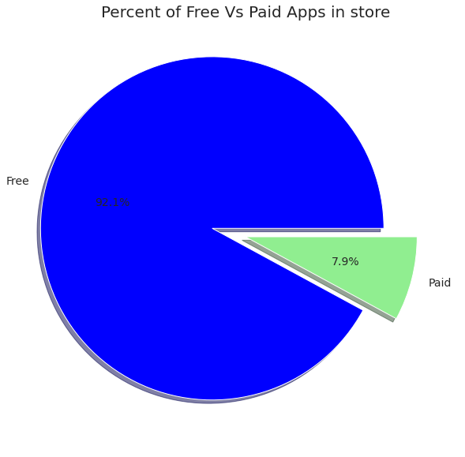
Let’s plot a visualization graph to view what portion of the apps in the play store are paid and free.
From the above graph, we can see that 92%(Approx.) of apps in the google play store are free and 8%(Approx.) are paid

Slide 14
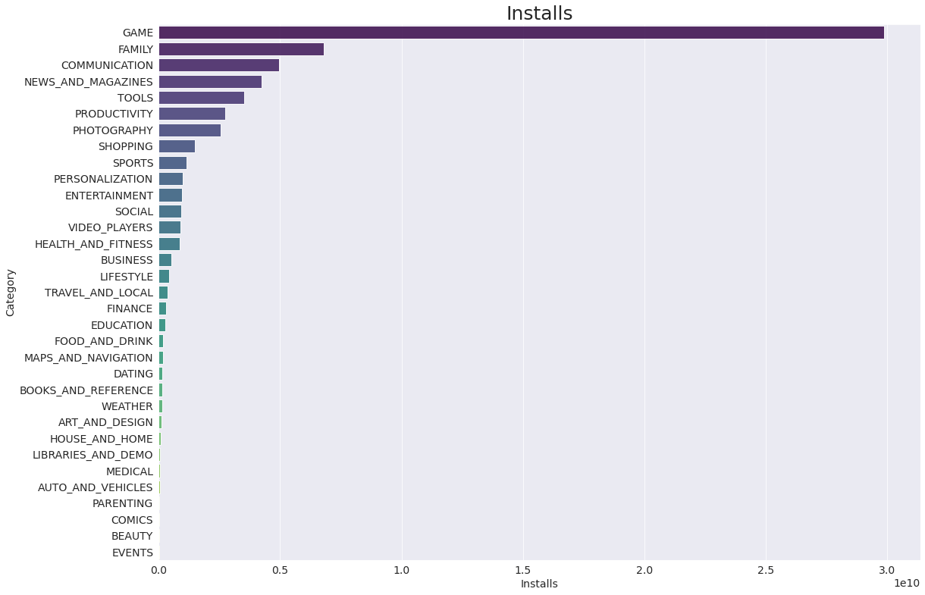
Which category App’s have the most number of installs?
From the above visualization, it can be interpreted that the top categories with the highest installs are Game, Family, Communication, News & Magazines, & Tools.

Slide 15
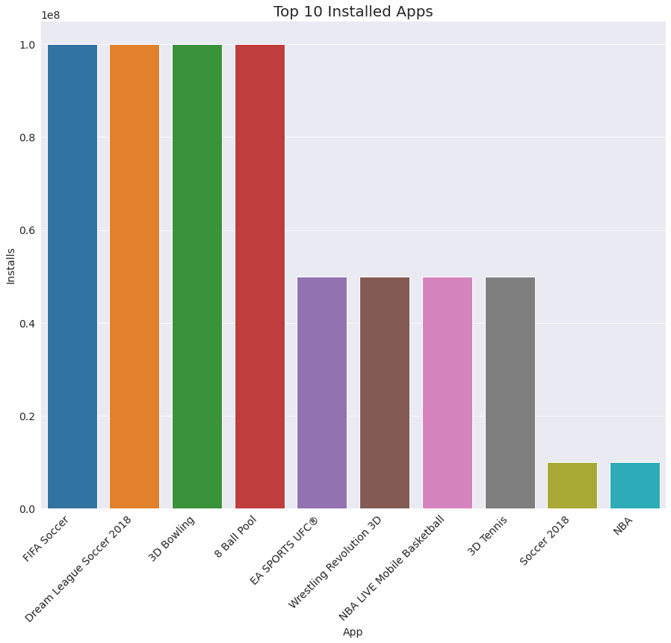
What are the Top 10 installed apps in any category?
From the above graph, we can see that in the Sports category FIFA Soccer, and Dream League Soccer 2018 has the highest installs. In the same way by passing different category names to the function, we can get the top 10 installed apps.

Slide 16
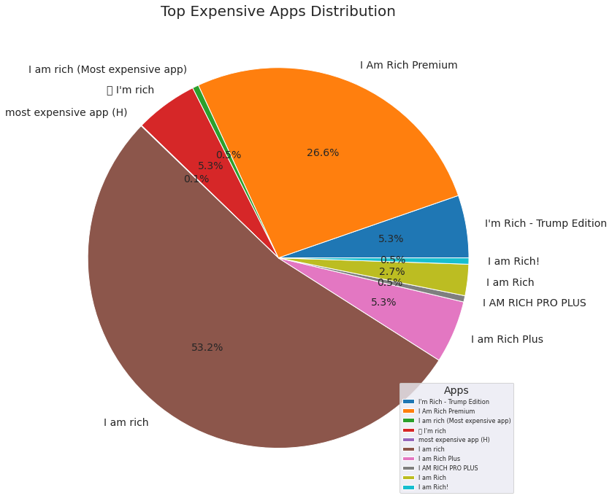
Which are the top 10 expensive Apps in the play store?
From the above graph, we can interpret that the App I am rich is the most expensive app in the google play store followed by I am Rich Premium. we also had to drop one-row data for this visualization because the language of the app was Chinese and it was messing with the pie chart, visualization.

Slide 17
Which App has the Highest reviews in the google play store
Apps_with_Highest_rev = googlestore_df.sort_values(by='Reviews', ascending=False).head(20)
From the above data frame we can interpret, and come to the conclusion that the Apps like Clash of Clans, Subway Surfers, Clash Royale, and Candy Crush Saga has the highest number of reviews on google play store.

Slide 18
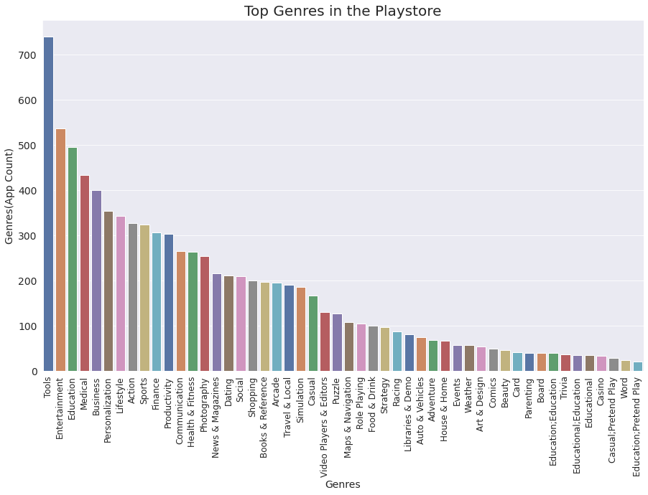
What are the count of Apps in different genres?
From the above visualization, we can see that the Highest Number of Apps found in the Tools and Entertainment genres followed by Education, Medical and many more.

Slide 19
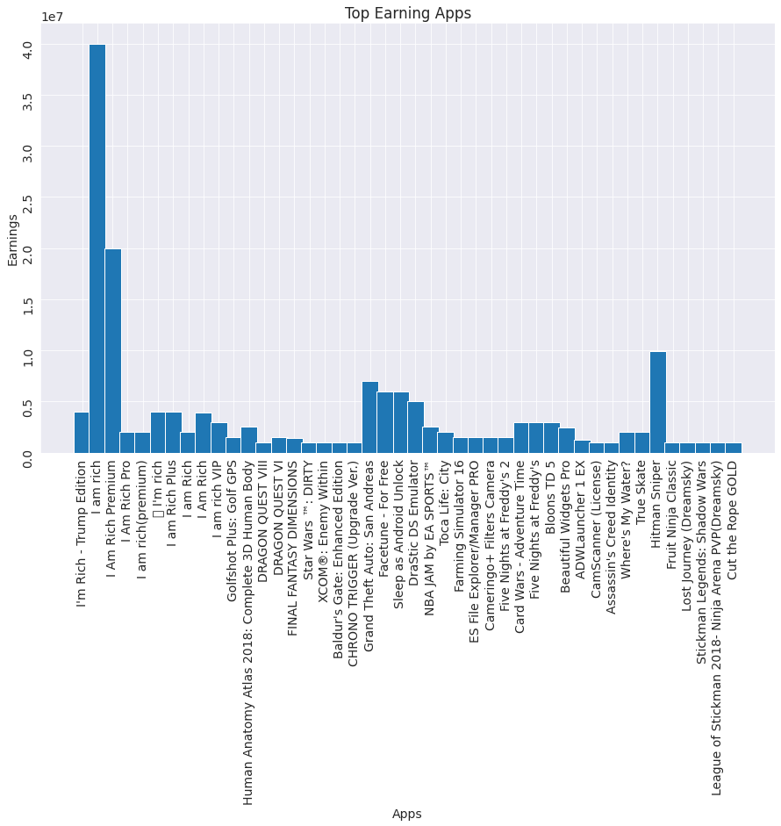
Which are the apps that have made the highest_earning?
For answering these questions we will need to perform some extra operation to the data frame, i.e., we will need to create a separate data frame, and then multiply the Price column and the Installs column in order to get the earning of any particular app. So, let's start the process.
We have finally come to an end to our analysis, and hope that if you have reached till here it must have been interesting or useful to you.

Slide 20
Conclusion
Top categories on Google Playstore?
Which category of Content is found more?
Distribution of the ratings of the apps?
What percentage of apps are Free and Paid?
Which category of apps has the most number of installs?
What are the Top 10 installed apps in different categories?
Which are the top expensive Apps? Which are the Apps with the highest number of reviews?
Count of Apps found in different genres? Which are the apps that have made the highest-earning?

Slide 21
THANK YOU FOR WATCHING MY VIDEO
THANK YOU FOR WATCHING MY VIDEO

